Slide 1
UCPath – UC Berkeley
Future State Business Process Discovery & Design Recap
03/21/2018

Slide 2
Objectives for Today’s Recap Meeting
Circle back and check in, following last week’s sessions on transaction templates, process steps, and workflow
Share follow-up on questions gathered during sessions, and gather any new questions since last week
Preview what to expect in upcoming Deep Dive sessions
Review JIRA collaboration tool, sample meeting schedule and expectations for participants

Slide 3
Last Week’s Future State Design
Met with identified SMEs to provide a foundational understanding of UCPath transactions, including templates, process steps and workflow
Performed a live in-system demo of templates, including Initiator view and Approver view
Discussed knowledge and skills that Initiators and Approvers must have to submit appropriate templates
Provided sample approval paths to begin future discussion and thought regarding identifying roles and processes

Slide 4
Questions: Follow-up
All questions asked during last week’s meetings were recorded and will be sent out following this meeting
While many unanswered questions have now been answered, some are still pending
Review questions and notify us if we have missed any questions: ucpathberkeleyinfo@lists.berkeley.edu
Questions and answers will be added to UCPath website

Slide 5
Q&A Document Organization
All questions are organized by category
If you asked a question that was not captured, let us know and we will add it
Email new or follow-up questions to ucpathberkeleyinfo@lists.berkeley.edu

Slide 6
What New Questions
Do You Have?

Slide 7
Local Business Process Design – Meetings
Session #1 March 8
Session #2 March 13
Session #3 March 14
Session #4 March 21
Deep Dive Series #1 March 26 – May 11
Deep Dive Series #2 May 14 – July 27
Project overview
Confirm SME participation
Review one transaction
Preview for Sessions 2 & 3
Cross-Functional Discovery
Demo transactions and workflow
Preview potential approval scenarios
Cross-Functional Discovery
Demo transactions and workflow
Preview potential approval scenarios
Q& A from Sessions 2 & 3
Preview Deep Dive Series
Deep Dives by transaction area
Deep Dives by transaction area
Next up!
You are here
Attendees: Central HR, APO, Controller's Office, CAO, Department HR, & CSS/ERSO
Notes:
Print along with Guiding principles to hand out to audience

Slide 8
Objectives for Deep Dive Sessions
Focus on:
Discovery and information gathering
Understanding pre-work, post-work and handoffs
Finding process improvement opportunities
Identifying how UCPath templates, processes and approval workflow can OPTIMIZE campus business practices

Slide 9
Deep Dive Sessions
Approach
Review end-to-end process for business area
Examine process steps to see where template Initiation and Approval can occur within process
Review Initiator and Approver roles and knowledge/skills required
Begin identifying Initiators and Approvers as appropriate for these activities
Also – Identify and document further business process adaptations and external system changes that could streamline, standardize and optimize future state

Slide 10
Being Prepared – Lessons Learned from Pilot
How will Deep Dives address ‘Lessons Learned’?
Governance – Deep Dive sessions will be inclusive
Testing – Deep Dive sessions will inform testing by identifying business process test cases and allowing broad participation for campus-wide readiness
UCPath Center – Deep Dive sessions will point out handoffs with UCPC and where UCB needs to engage and establish relationships for efficient issue resolution

Slide 11
Business Process Design Sessions
Participants
Attend deep dive sessions presented in calendar
Attend with HR business partner
Use the guiding principals to collaborate
Maintain enterprise-wide perspective
Be open to processes and role changes
Be transparent with communications
Meeting Schedule
All participants will receive invitations for ALL meetings – Select those relevant to your area
Plan ahead to attend deep dive sessions with HR business partner
Check in JIRA for updated meeting schedule
JIRA Collaboration Tool
Log into Jira to review meeting notes from deep dive sessions
Log into Jira to review questions and provide comments on process
Notes:
Print along with Guiding principles to hand out to audience

Slide 12
Local Business Process Design - Guiding Principles
Sponsor Alignment
Develop efficiency in end-to-end business process
Use UCPath delivered functionality
Minimize additional cost
Eliminate double data entry
Diverse Campus Stakeholders
Involve both academics and staff (at multiple levels)
Maintain a customer focus
Disciplined Process
Ensure implementation focus
Use UCPath delivered templates and approval workflow
Document decisions for clarity and commitment
Openness to Change
Maintain enterprise-wide perspective
Be open to process and role changes
Be transparent with communications

Slide 13
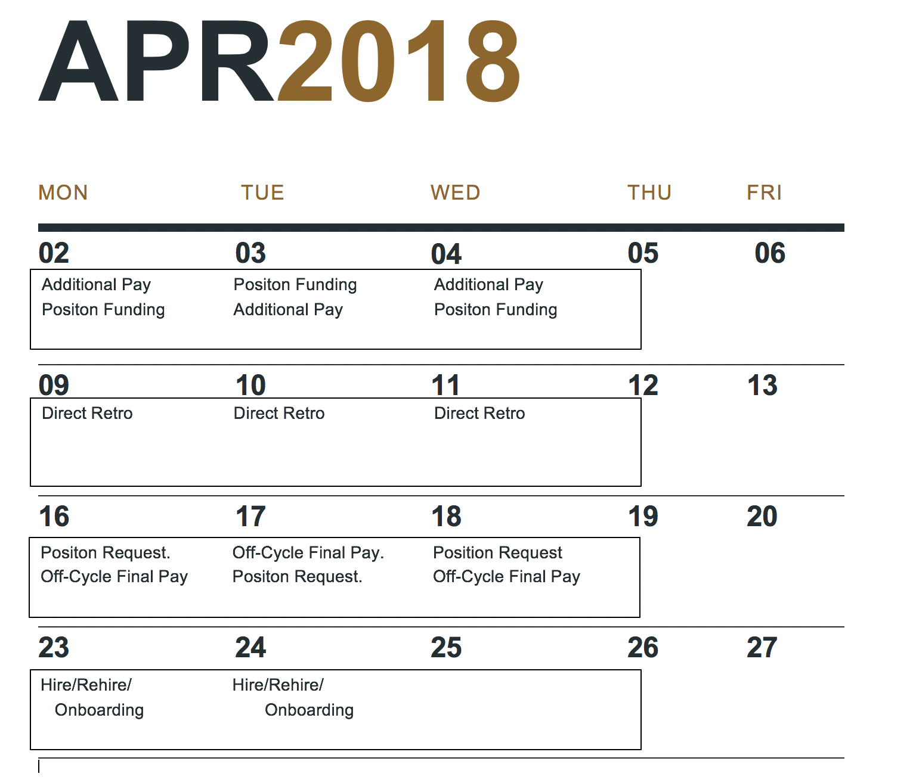
Local Business Process Design – Meetings
Notes:
Print along with Guiding principles to hand out to audience

Slide 14
How and when do I need to get involved?
Log into Jira and check out the deep dive session schedule
Participate in discovery and design sessions – Carry the message back to your home department and share information
Check out our website https://ucpath.berkeley.edu/
Read and share our monthly communication cheat sheet
Participate in department-specific town hall / focus groups to explain what’s going to be different as part of OCM activity
Participate in training and provide feedback

Slide 15
UCPath Communication Cheat Sheet
What You Need to KNOW
UC Berkeley is working on configuration templates for conversion:April 15 2018
UCPath is not just a “technology project” - UC Berkeley will still own most of the business processes that feed into the UCPath workflow, so this is an opportunity to improve some of our processes
Starting in March, we will be discussing UC Berkeley’s business processes in preparation for UCPath go-live. The kick-off is scheduled for March 8th 2018
UC Berkeley website launched. Link https://ucpath.berkeley.edu/
What You Need to DO
Start talking about UCPath in your staff meetings (if you haven’t already) – use the Communication cheat sheet we will provide each month
Help identify SME’s who will participate in 2 day session(March 13th & 14th) followed by deep dive sessions by business area from March 26th to July 27th
What You Need to communicate
UCPath Go-Live date is currently scheduled for: March 2019
UCPath is a mandatory change initiative for all UC’s therefore participate in local business process discovery and design sessions to ensure roles and responsibilities are defined and ready for training and testing
If you have any questions regarding UCPath please contact us at ucpathtechinfo@lists.berkeley.edu
March 2018
For Help with Functional Questions: UCPath Functional Office Hours
Every Tuesday from 1 – 2PM (PST)
Telephone: (669) 900-6833 or (877) 369-0926 (Toll Free)
Meeting ID: 101 157 755
For Help with Technical Questions: UCPath Technical Office Hours
Every Thursday from 1 – 2PM (PST)
Telephone: (669) 900-6833 or (877) 369-0926 (Toll Free)
Meeting ID: 857 981 295
Notes:
Pratima

